Slide 1

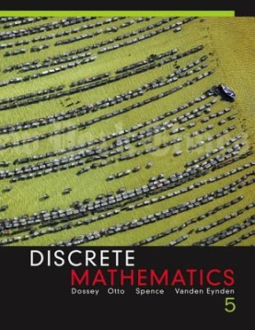
Propositional Logic – Logical Equivalence
By Mohammed Ahsan Meah

Slide 2


Slide 3
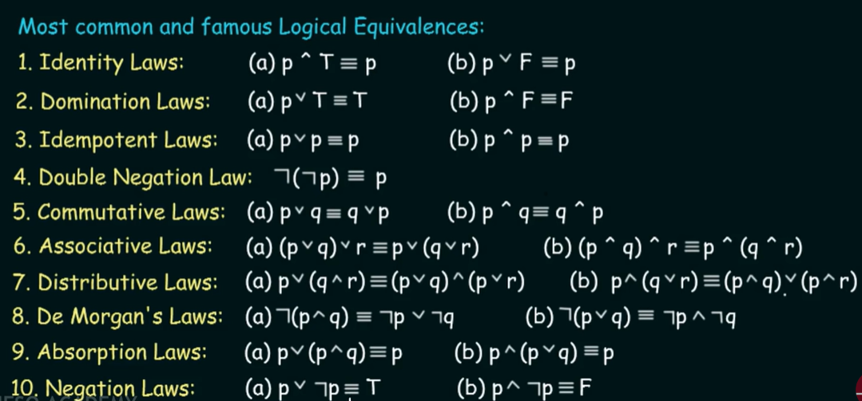

Slide 4
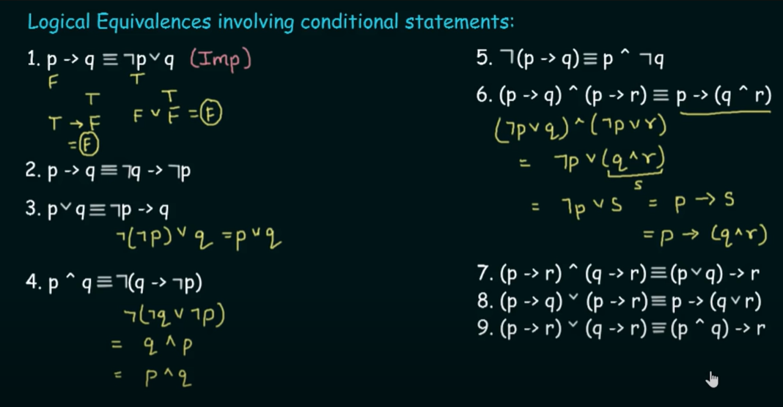

Slide 5
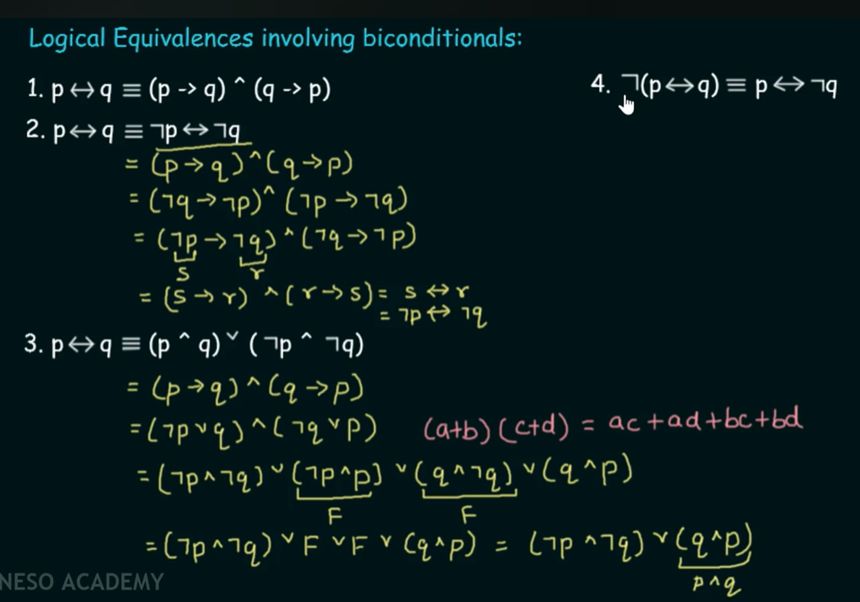

Slide 6


